Slide 1

Reproducible Machine Learning
Why and how to accomplish reproducibility in ML pipelines

Slide 2
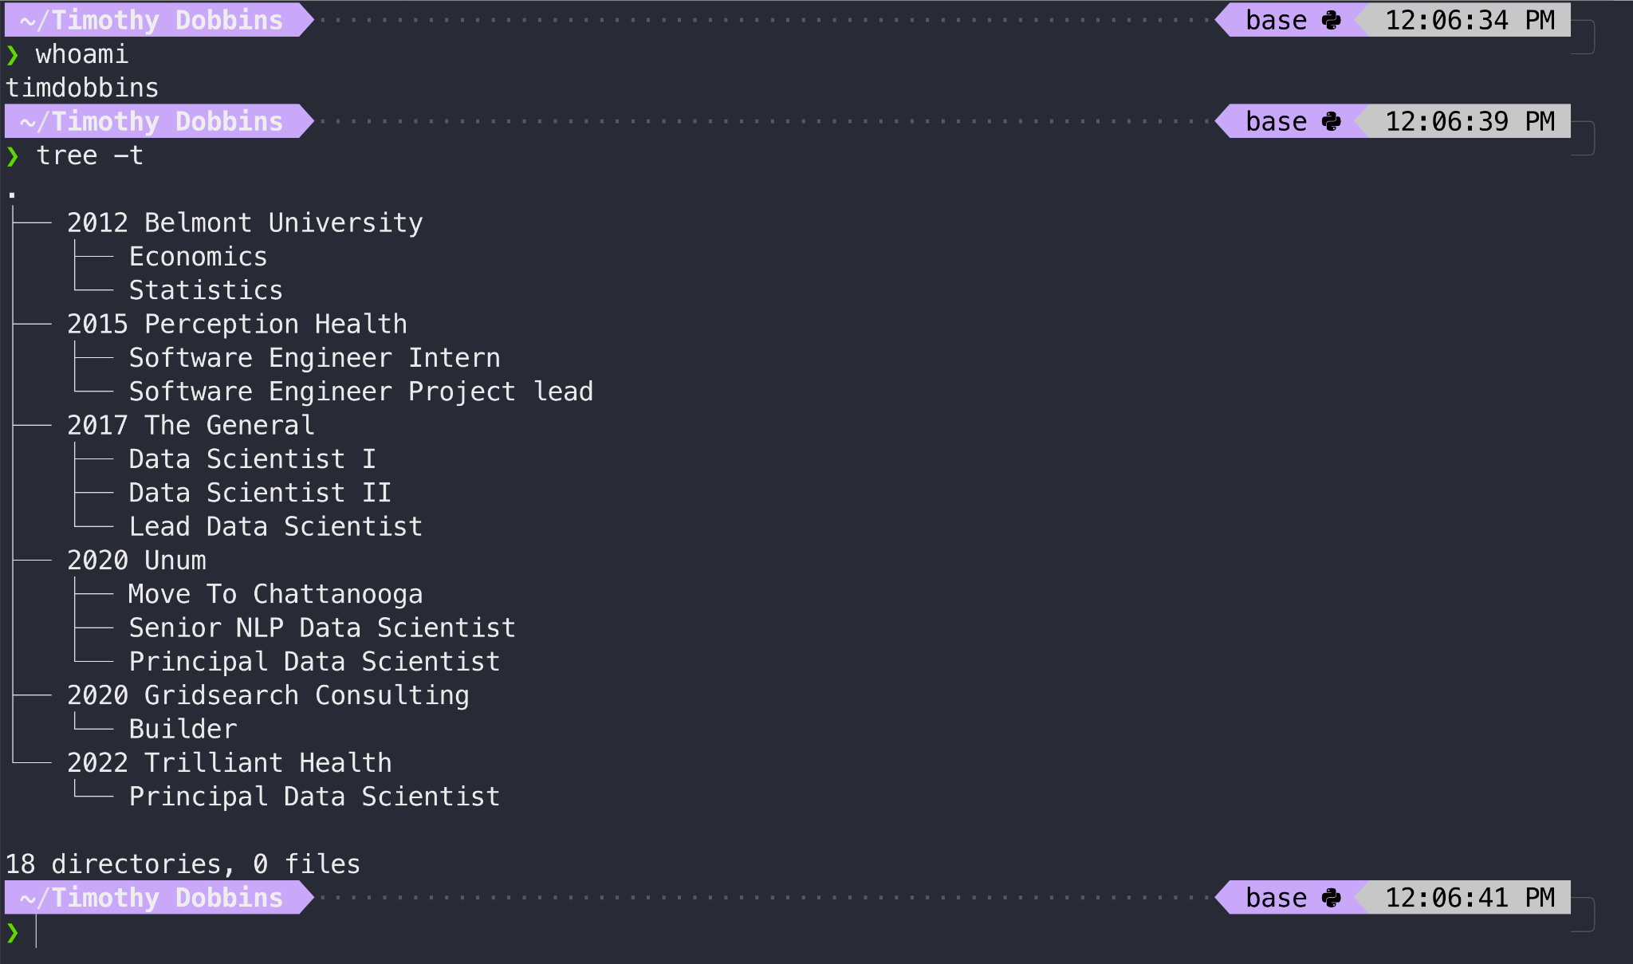

Slide 3
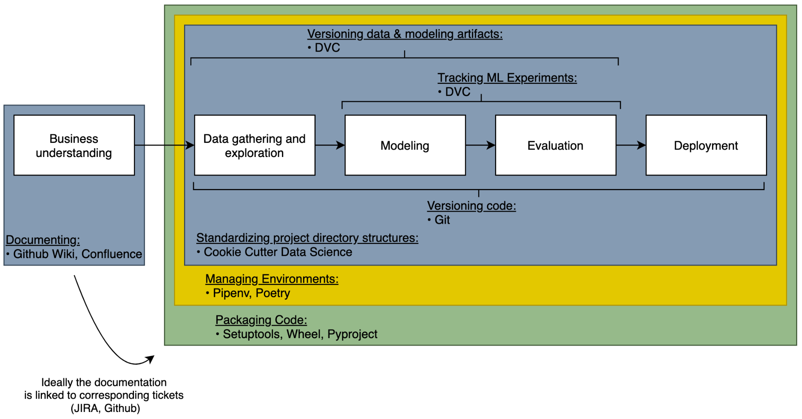
An ML reproducibility framework

Slide 4
Why reproducible machine learning?

Slide 5
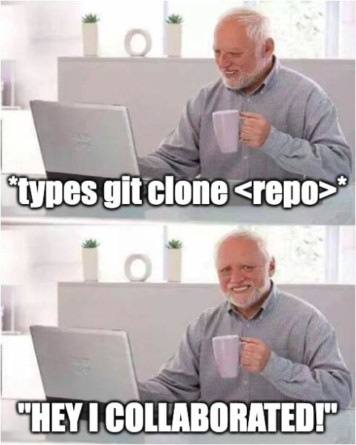

Why reproducible machine learning?
Collaborating
Notes:
To collaborate, everyone should be able to work with the same environmental dependencies with the same code and artifacts to produce the same results.
Without reproducibility, collaboration is impossible.

Slide 6

Why reproducible machine learning?
Collaborating
Debugging (remotely)
Notes:
Debugging locally is easy. It always works on my computer.
But debugging in a remote environment means you first have to get the codebase running in a non-local environment. Without reproducibility, this is untenable.

Slide 7
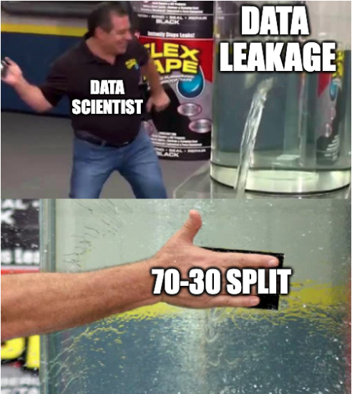
Why reproducible machine learning?
Collaborating
Debugging (remotely)
Scientifically validating
Notes:
If your data science isn’t reproducible it’s not scientific.
Whether it’s workforce that needs to forecast optimal number of workers in a given time window, claims needing to project how many cars will be total losses, or finance needings to analyze how much DS is making or saving to justify the spend, without reproducibility the numbers are unreliable.
Data pipelines, transformations, training-serving skew, properly handled validation sets, tracking model trainings, hyper-parameter tuning.

Slide 8
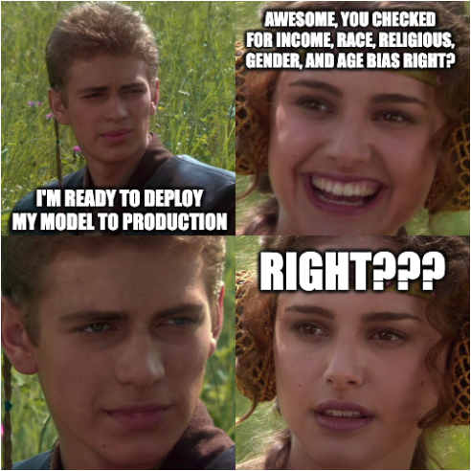
Why reproducible machine learning?
Collaborating
Debugging (remotely)
Scientifically validating
Auditing
Notes:
Whether it’s a regulatory entity approving the methodology of a model or an internal model auditing team detecting bias in an algorithm, without reproducibility audits aren’t feasible—which my be a blocker for many projects.

Slide 9
How to accomplish reproducibility?

Slide 10
Four components to account for

Slide 11
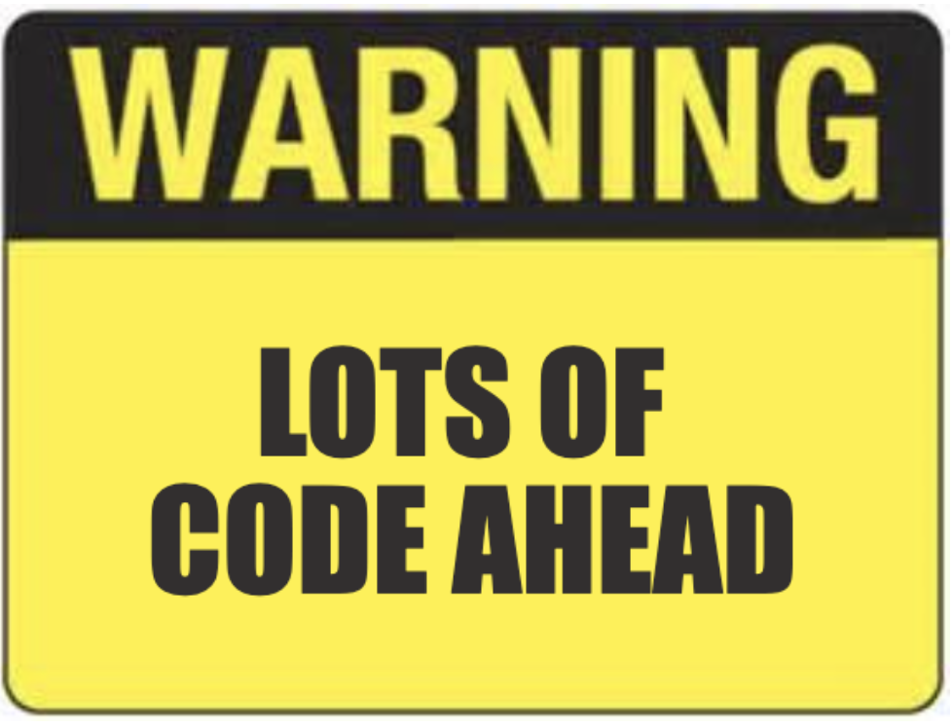
Four components to account for

Slide 12
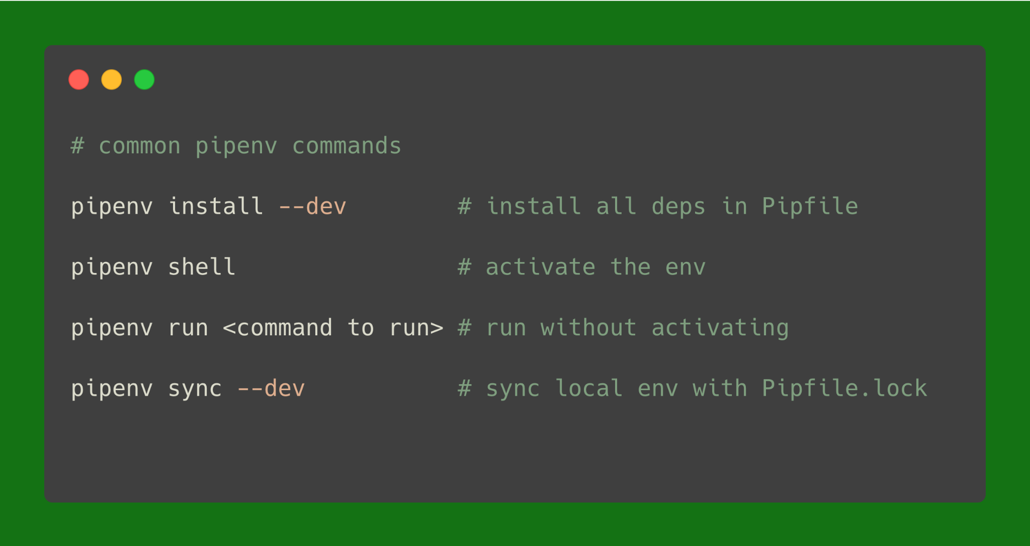
1. Environment

Slide 13
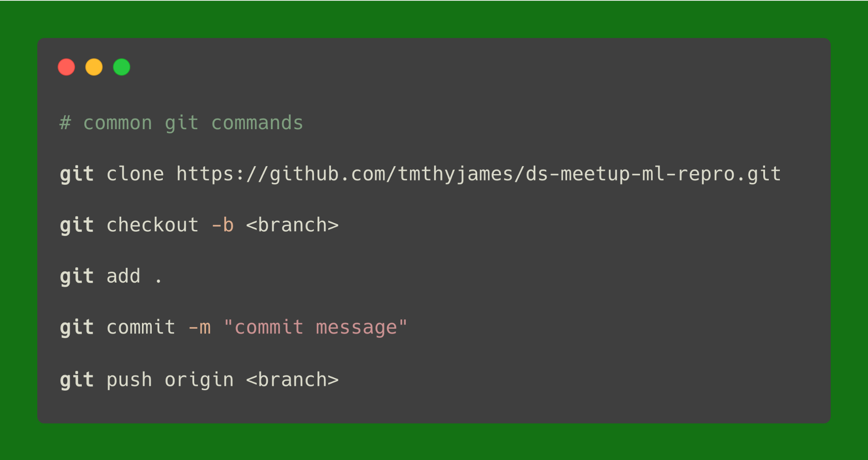
2. Code

Slide 14
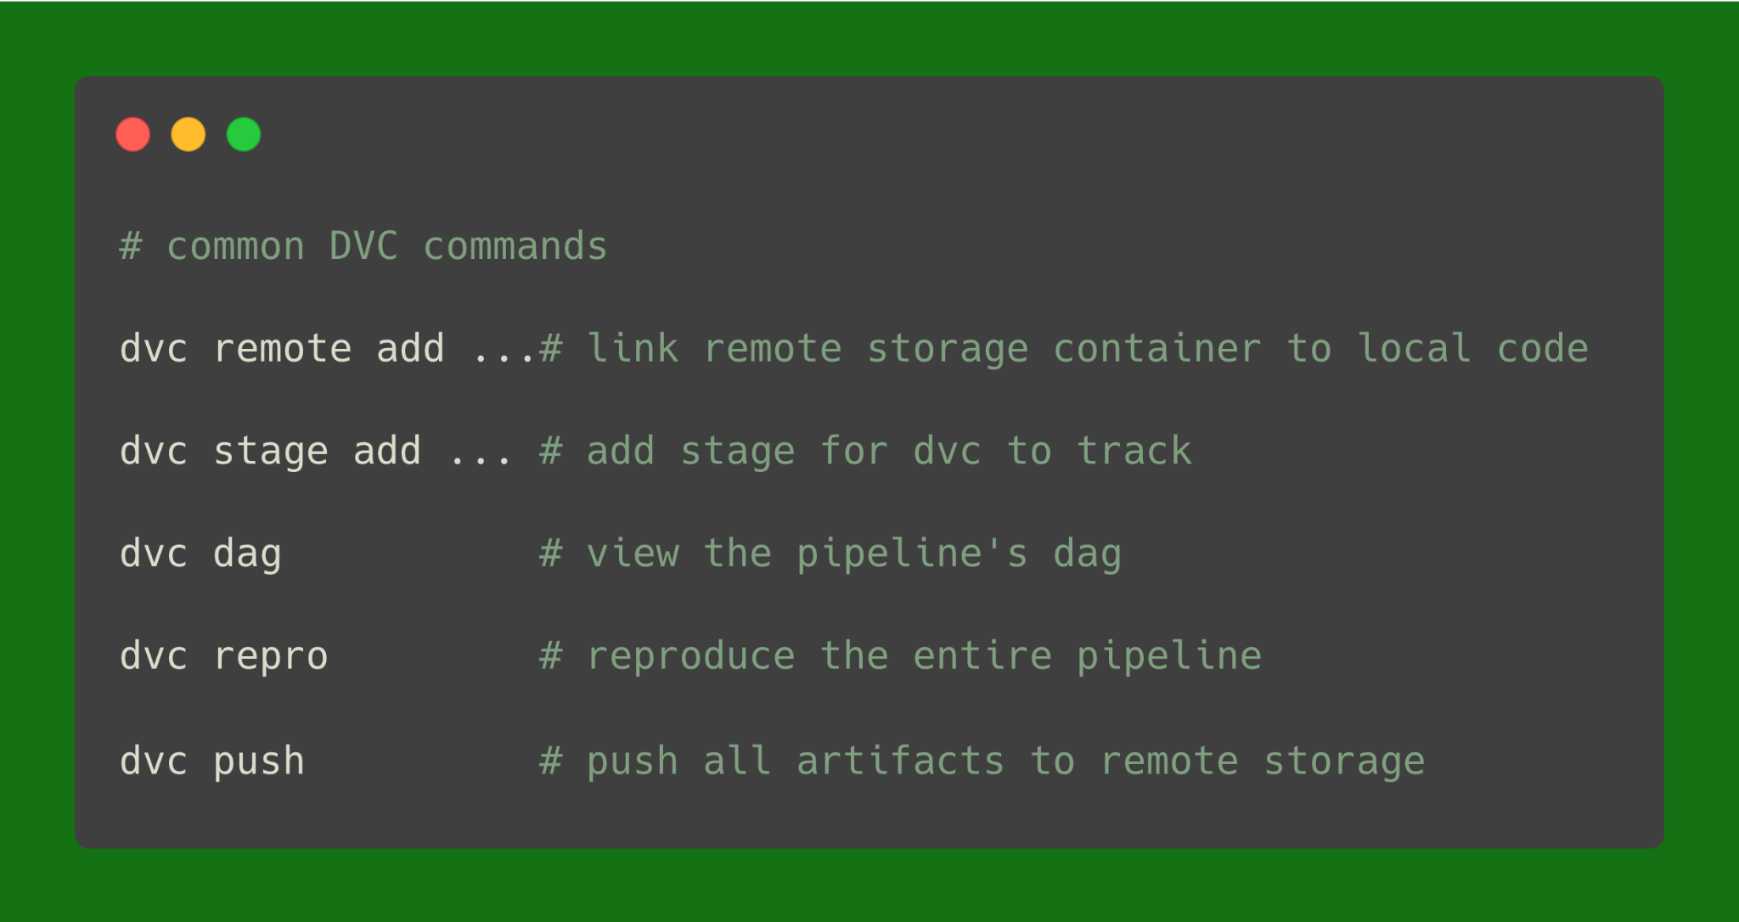
3. Data (data & model artifacts)

Slide 15
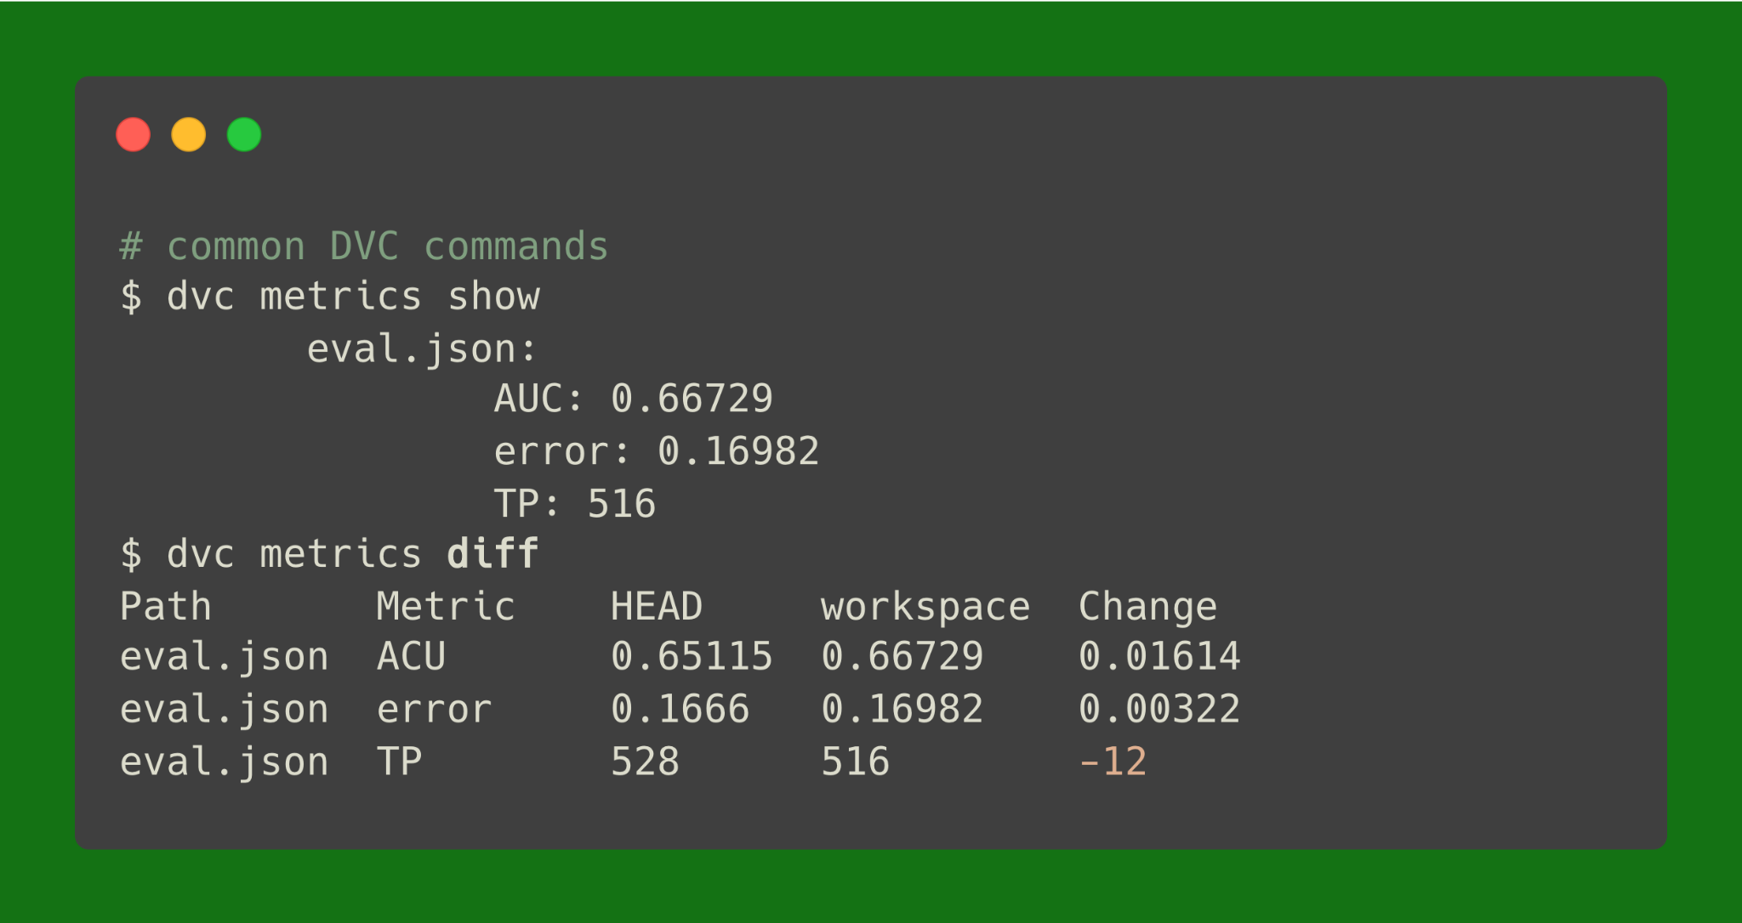
4. Results (performance metrics)

Slide 16
Let’s walkthrough an example

Slide 17
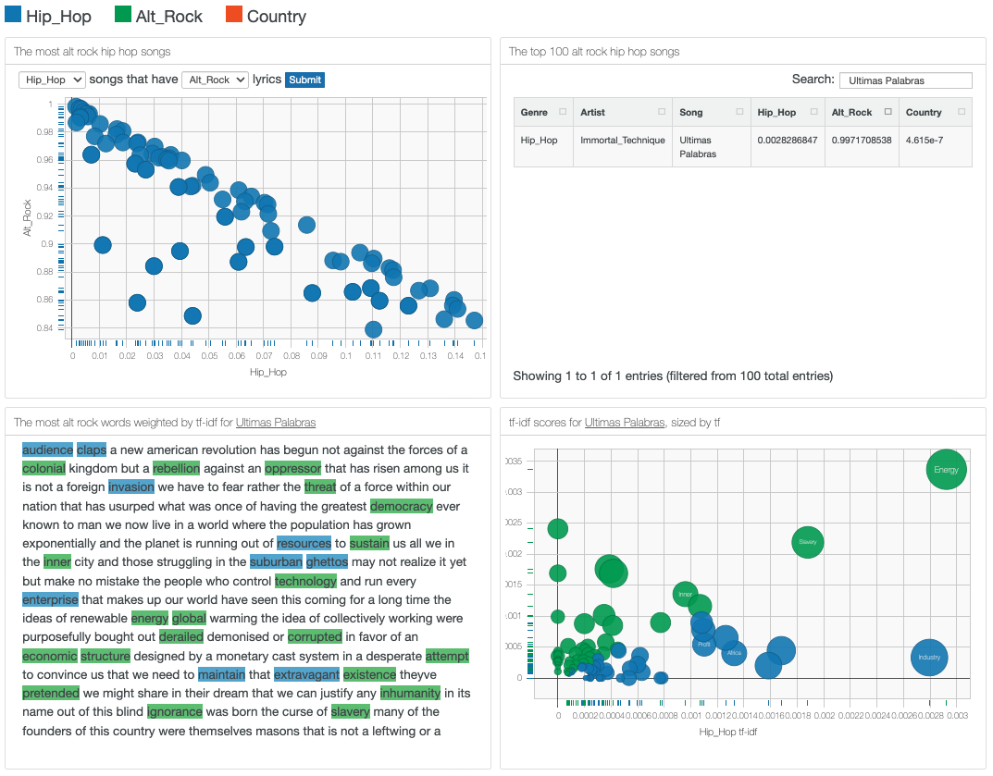


Predicting a song’s genre given its lyrics
← Link to blog
← Link to code

Slide 18
Setting up the environment

Slide 19
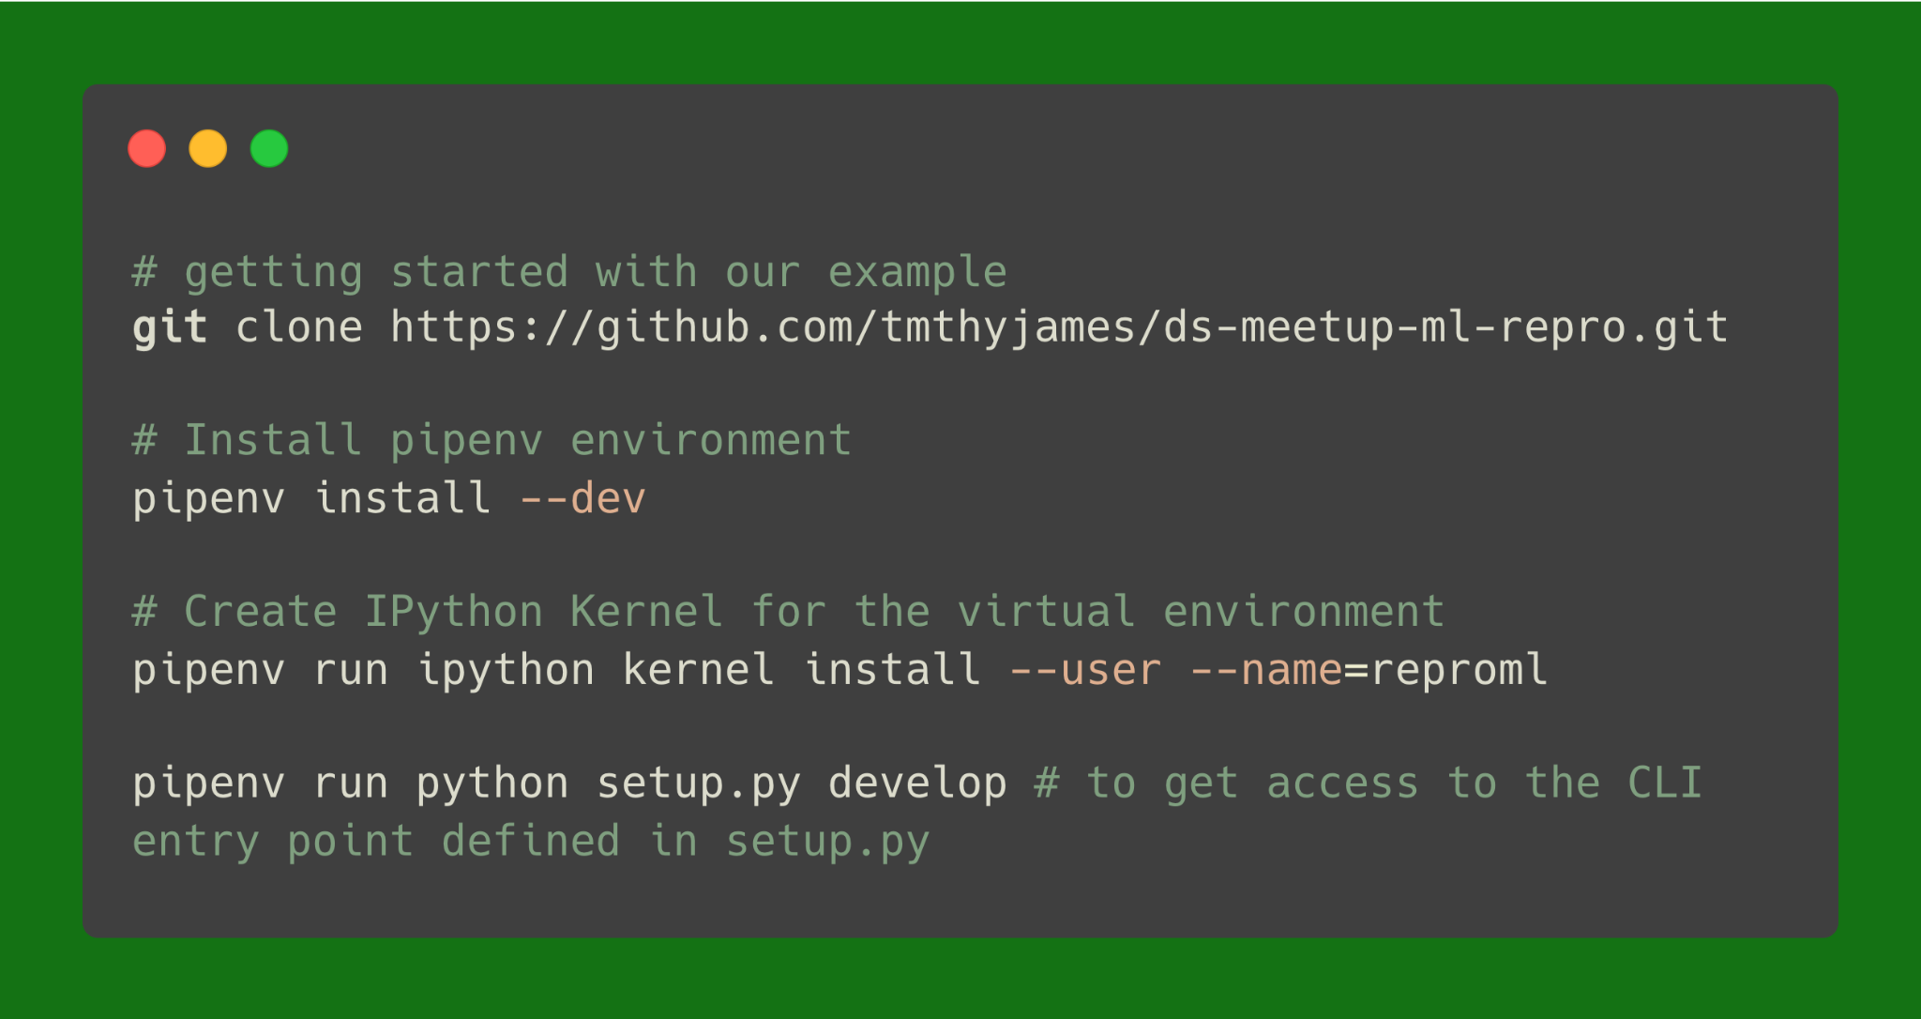
Setting up the environment

Slide 20
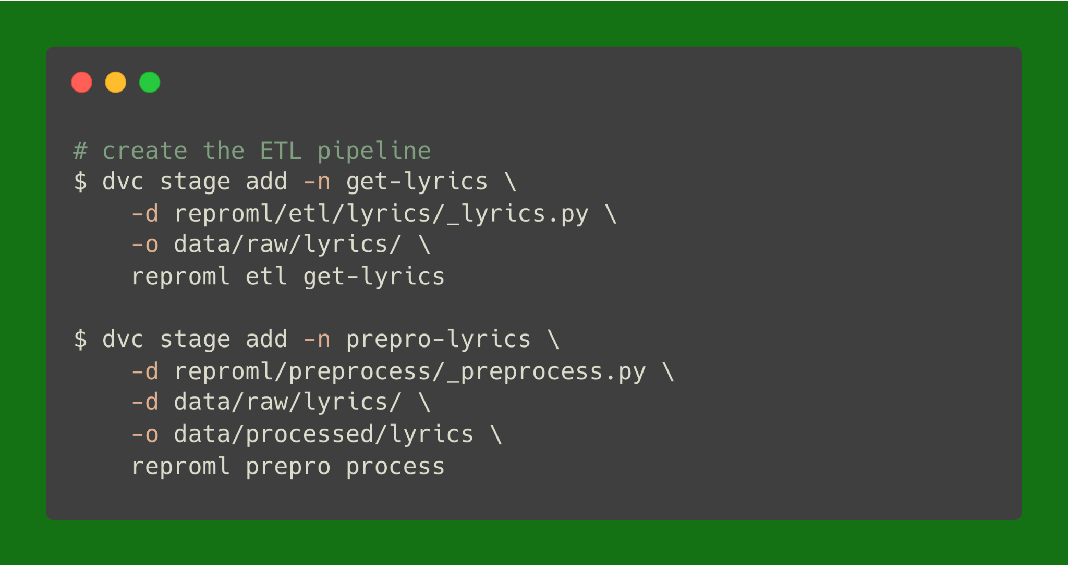
Creating the ETL pipeline using DVC

Slide 21
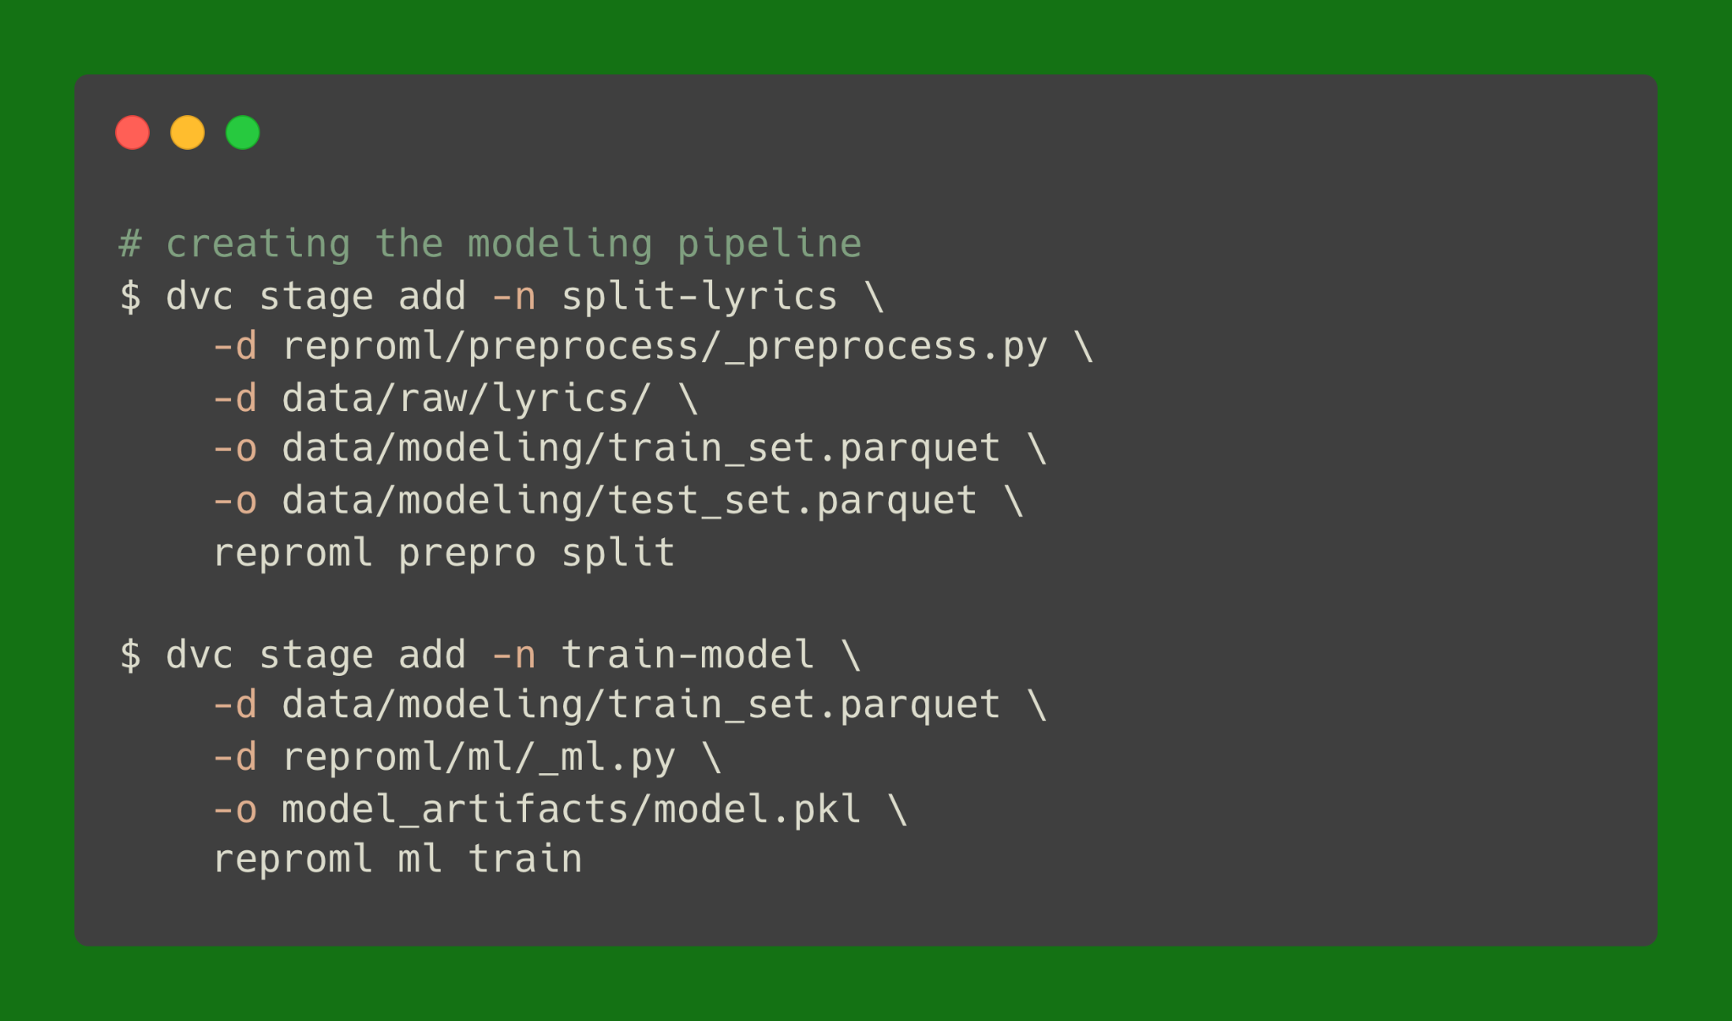
Creating the modeling pipeline using DVC

Slide 22
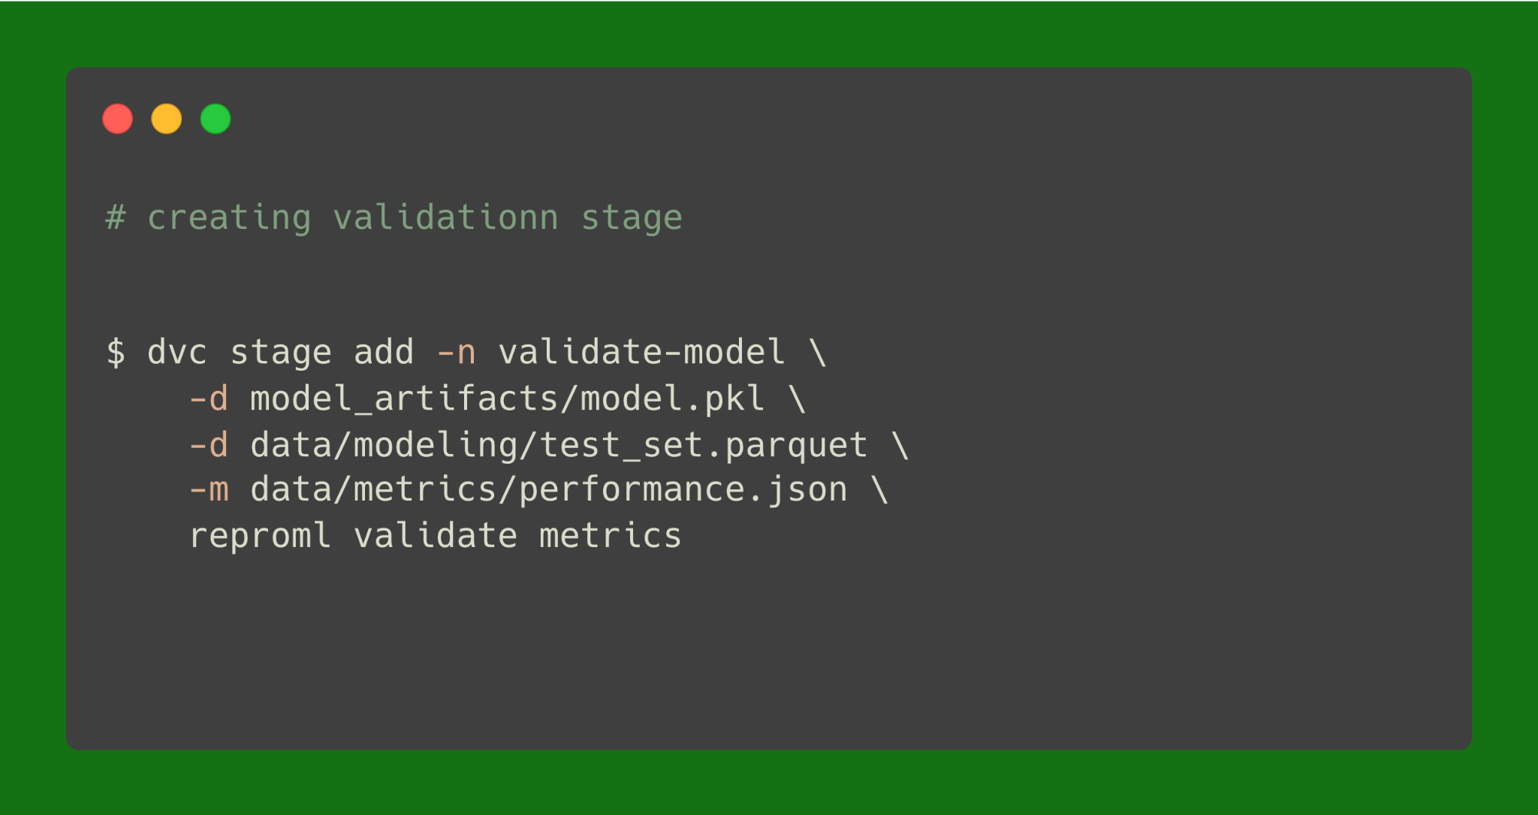
Creating the validation stage using DVC

Slide 23
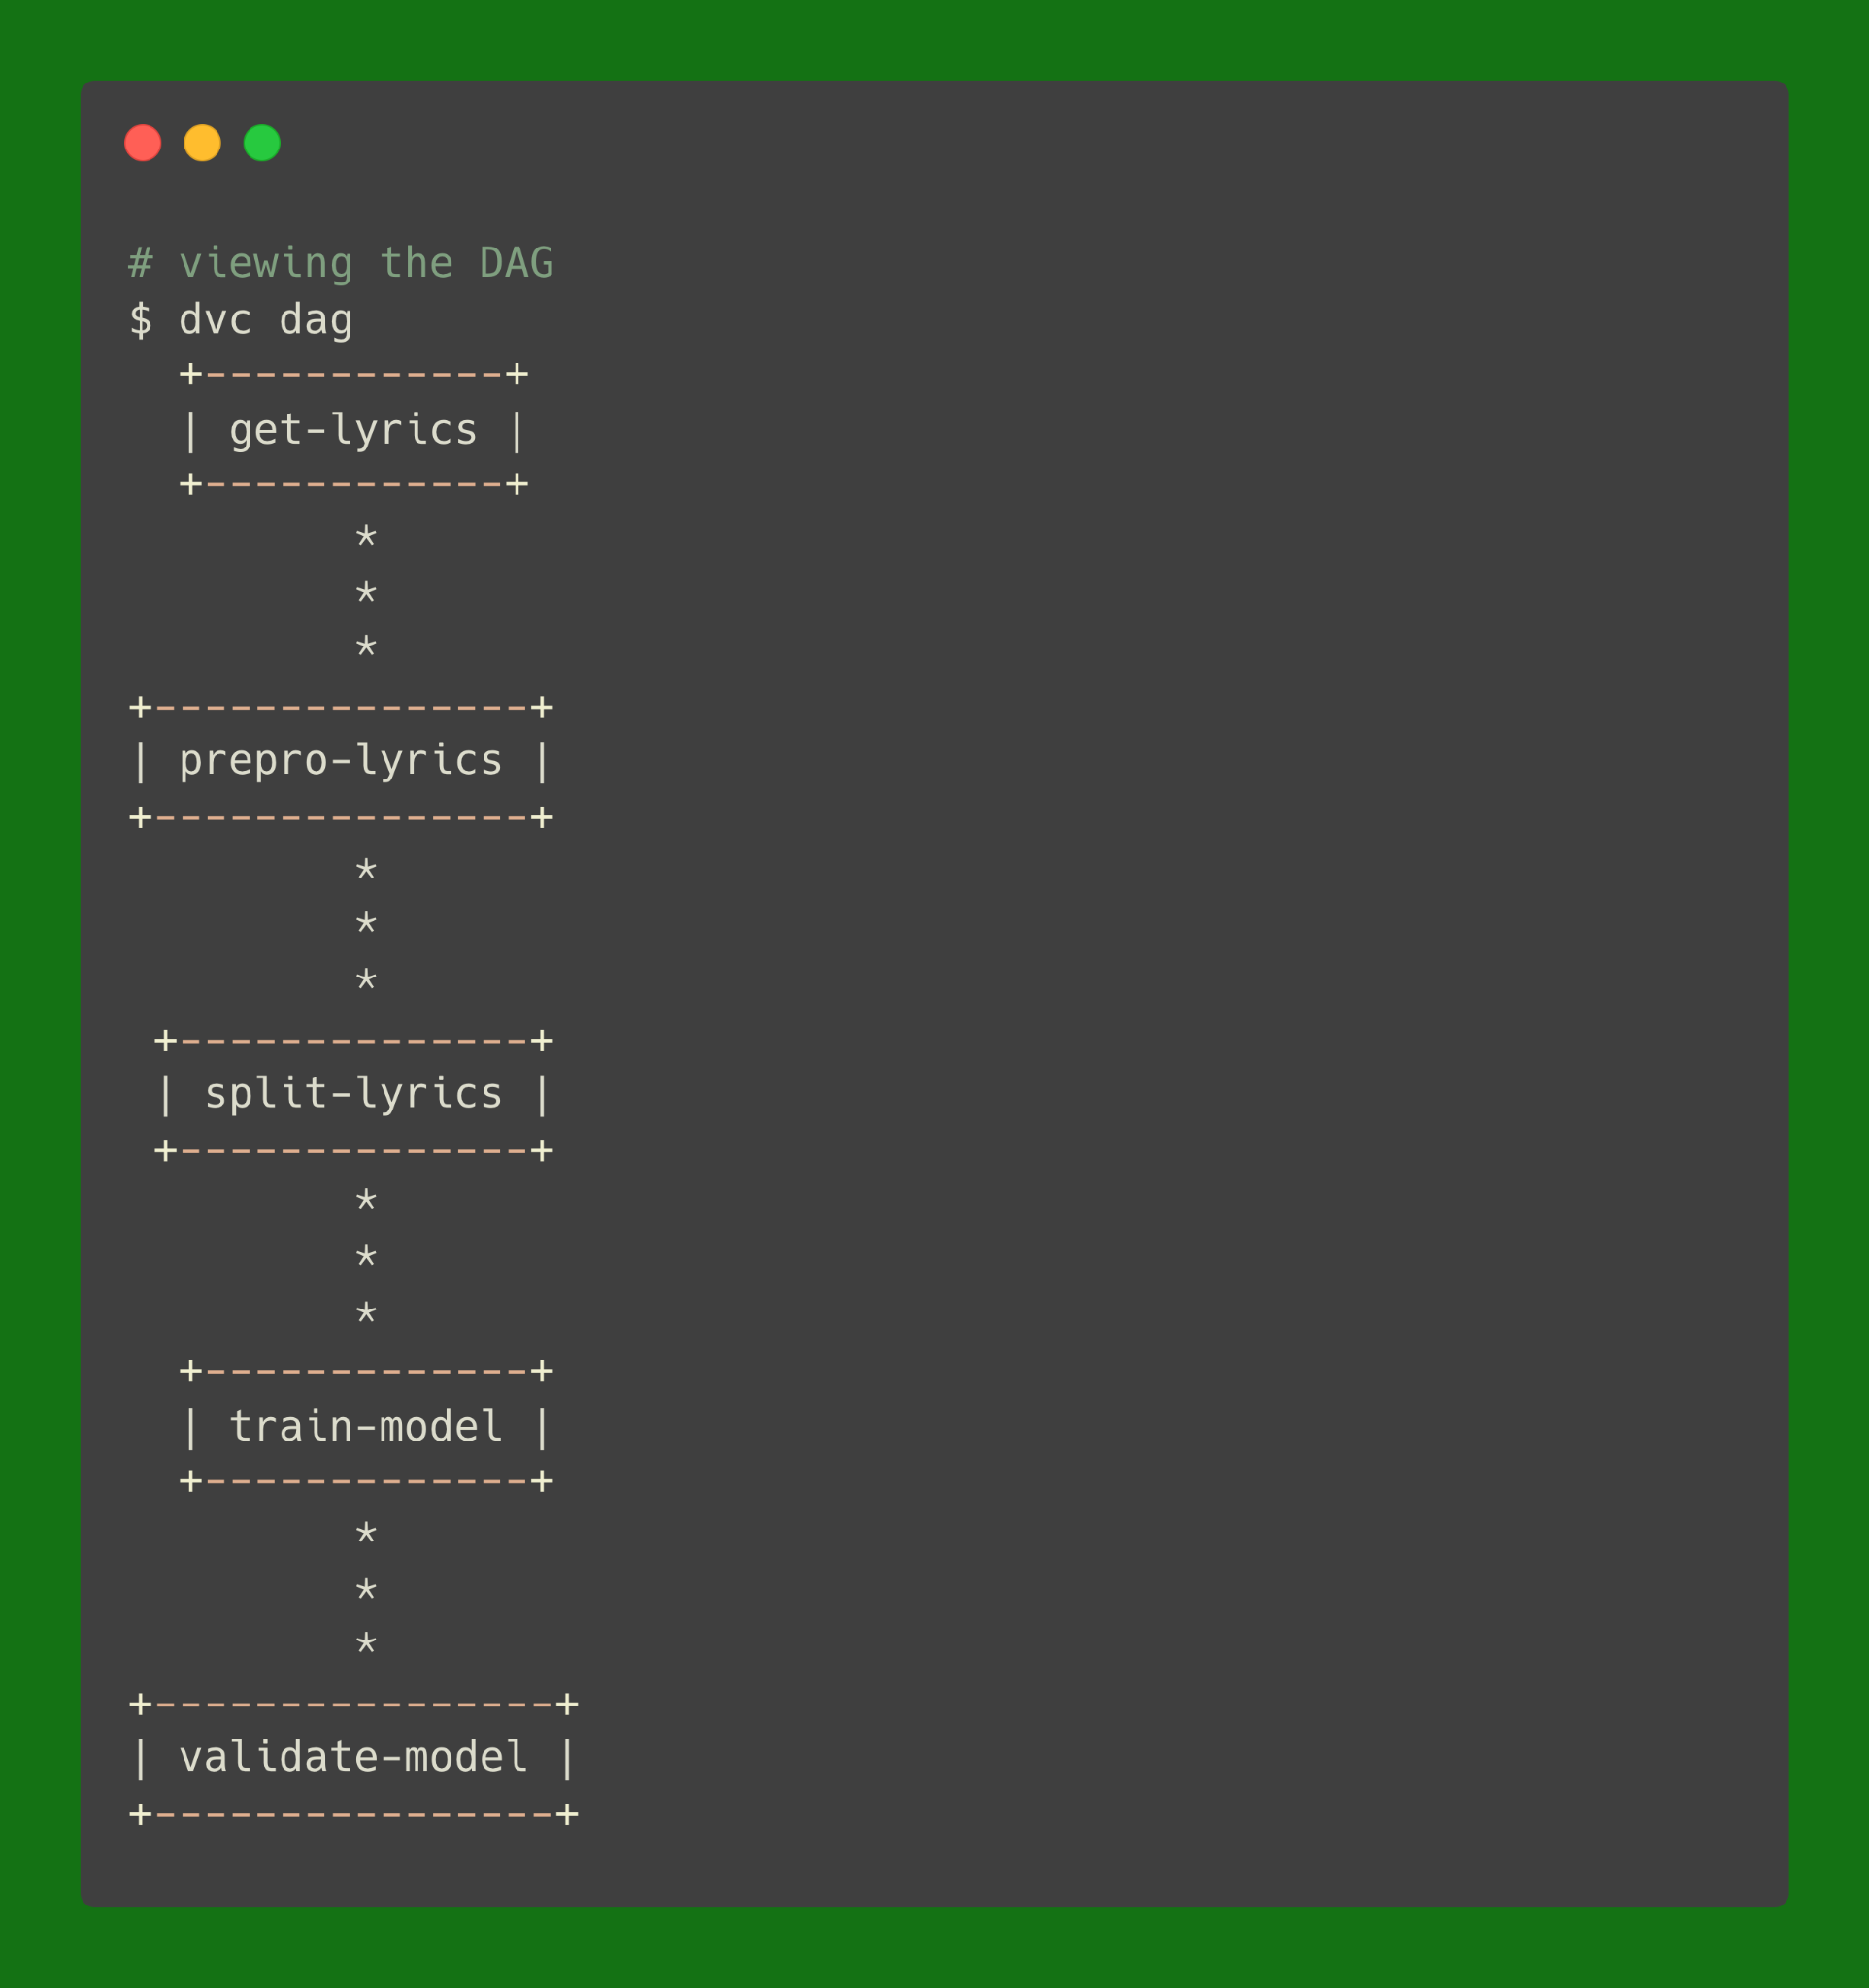
Now we can view our DAG

Slide 24
Now DVC knows how to track our pipeline
DVC will track changes
DVC will add all tracked files to a remote storage
DVC knows how to handle branches

Slide 25
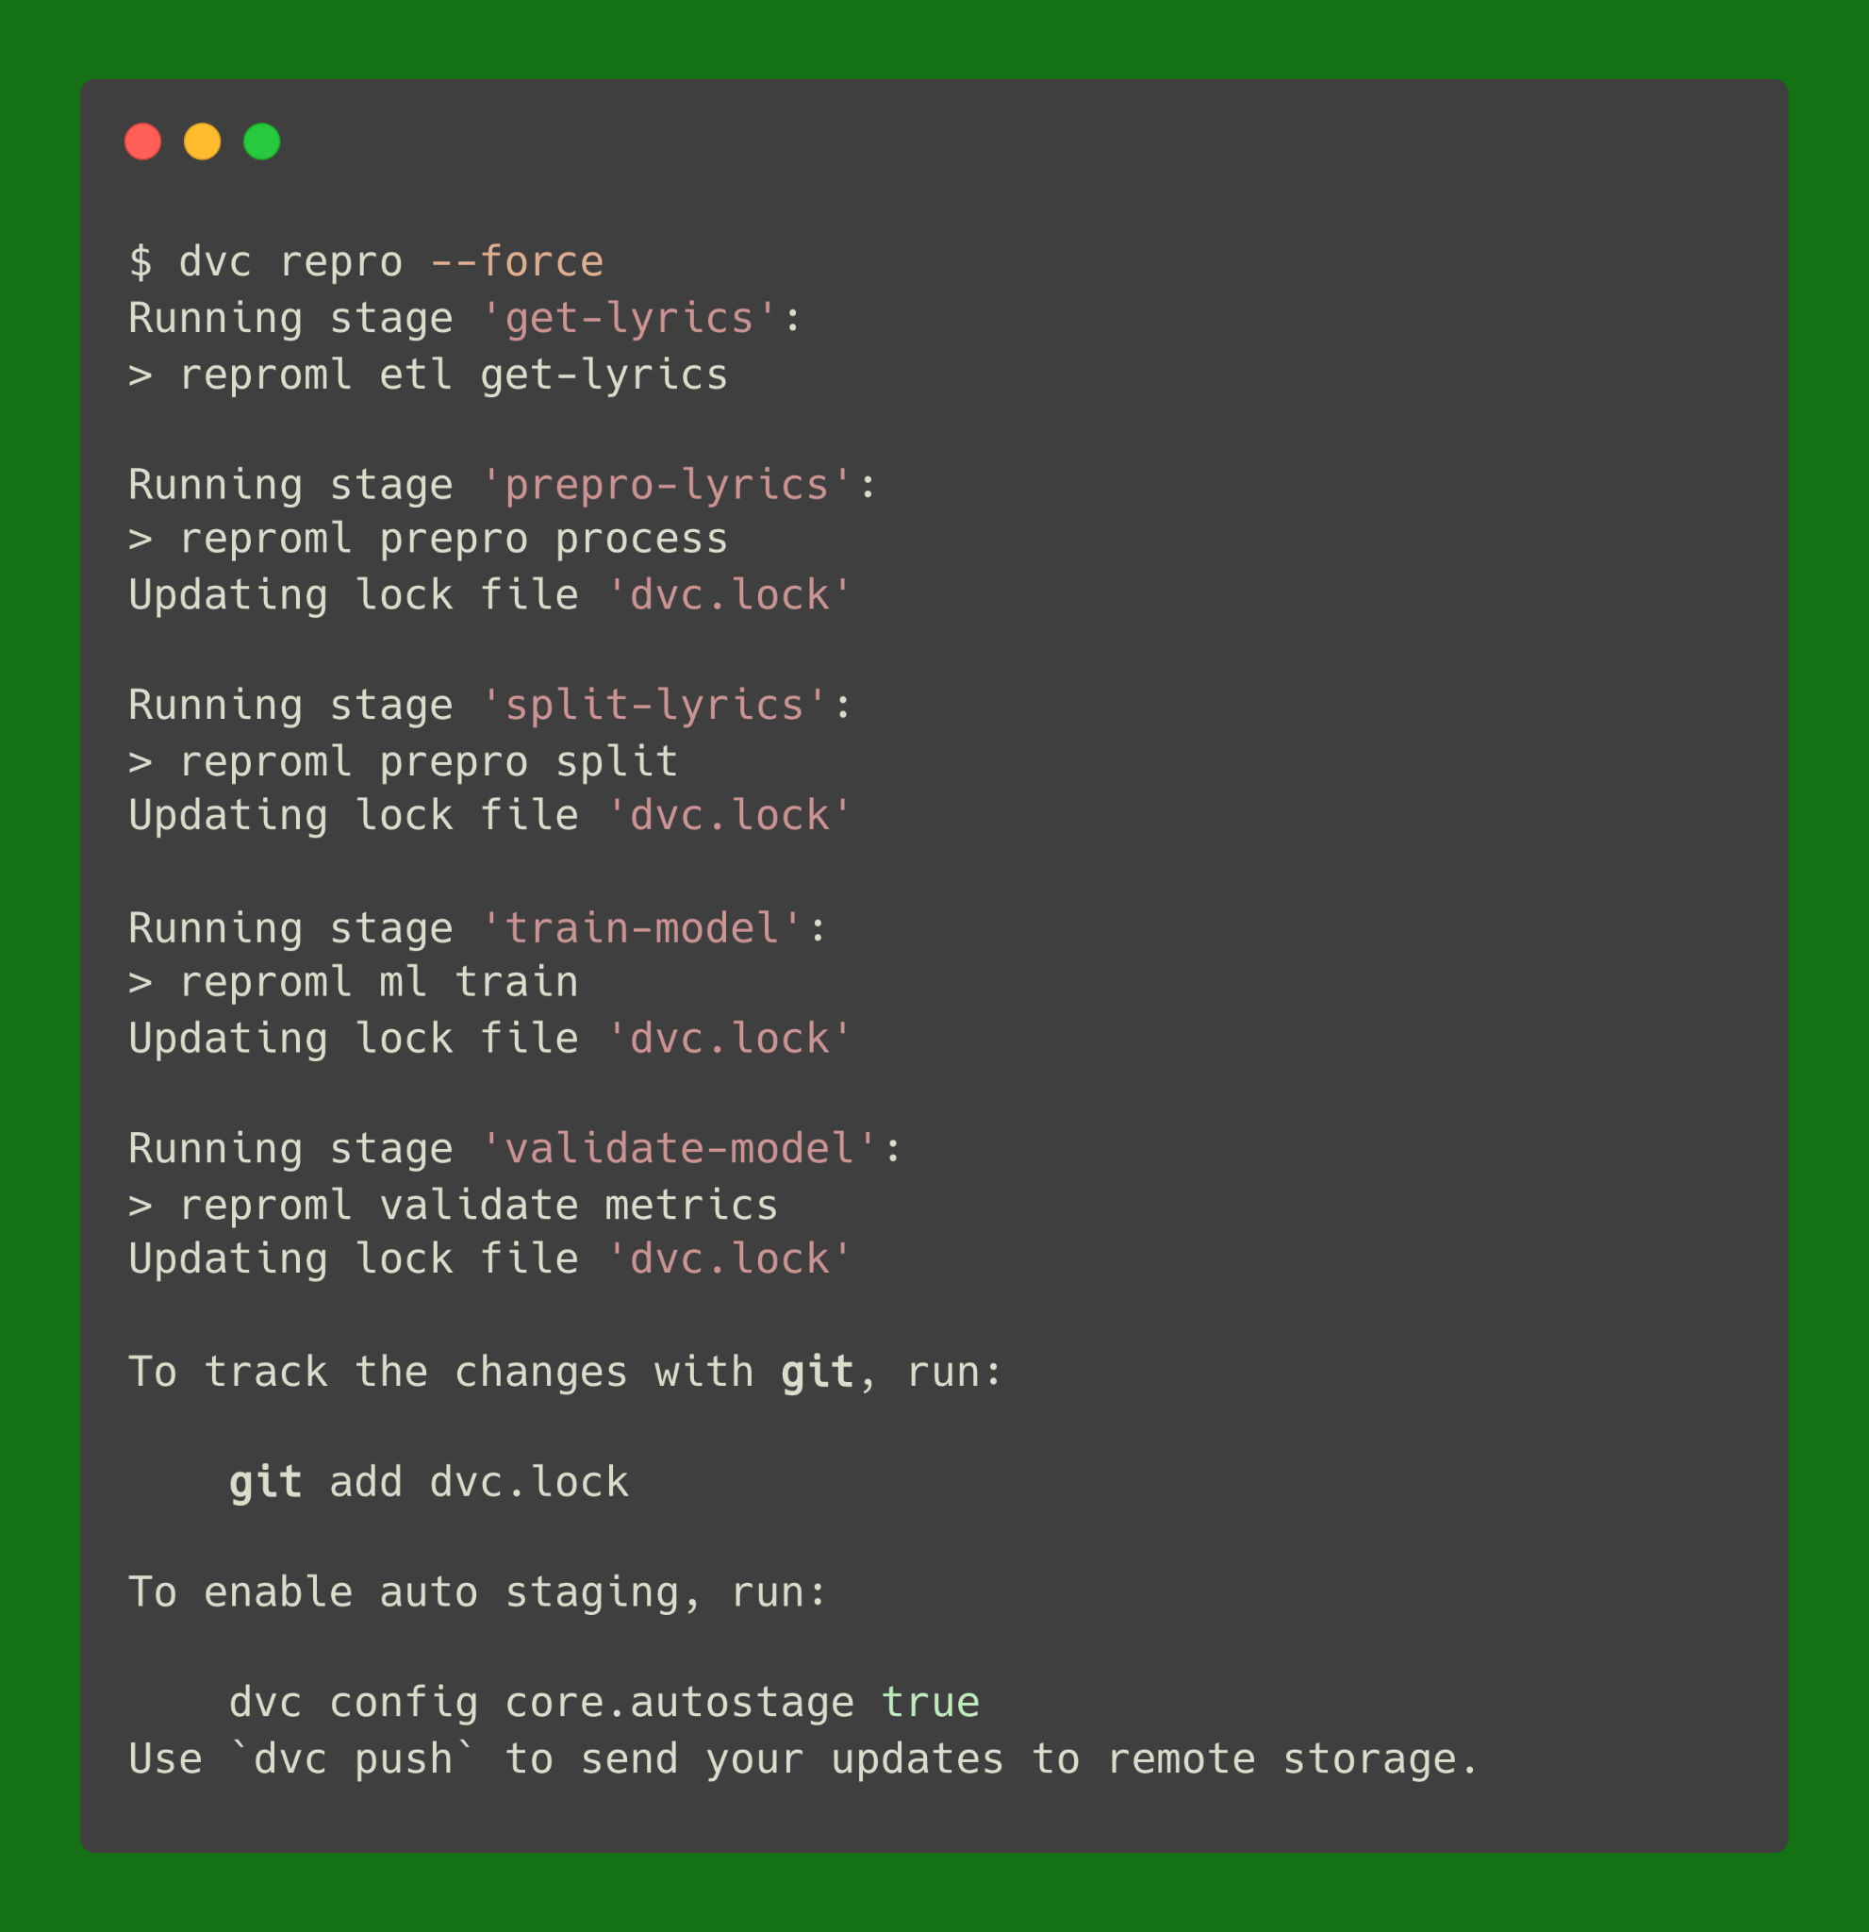
Let’s run the pipeline

Slide 26
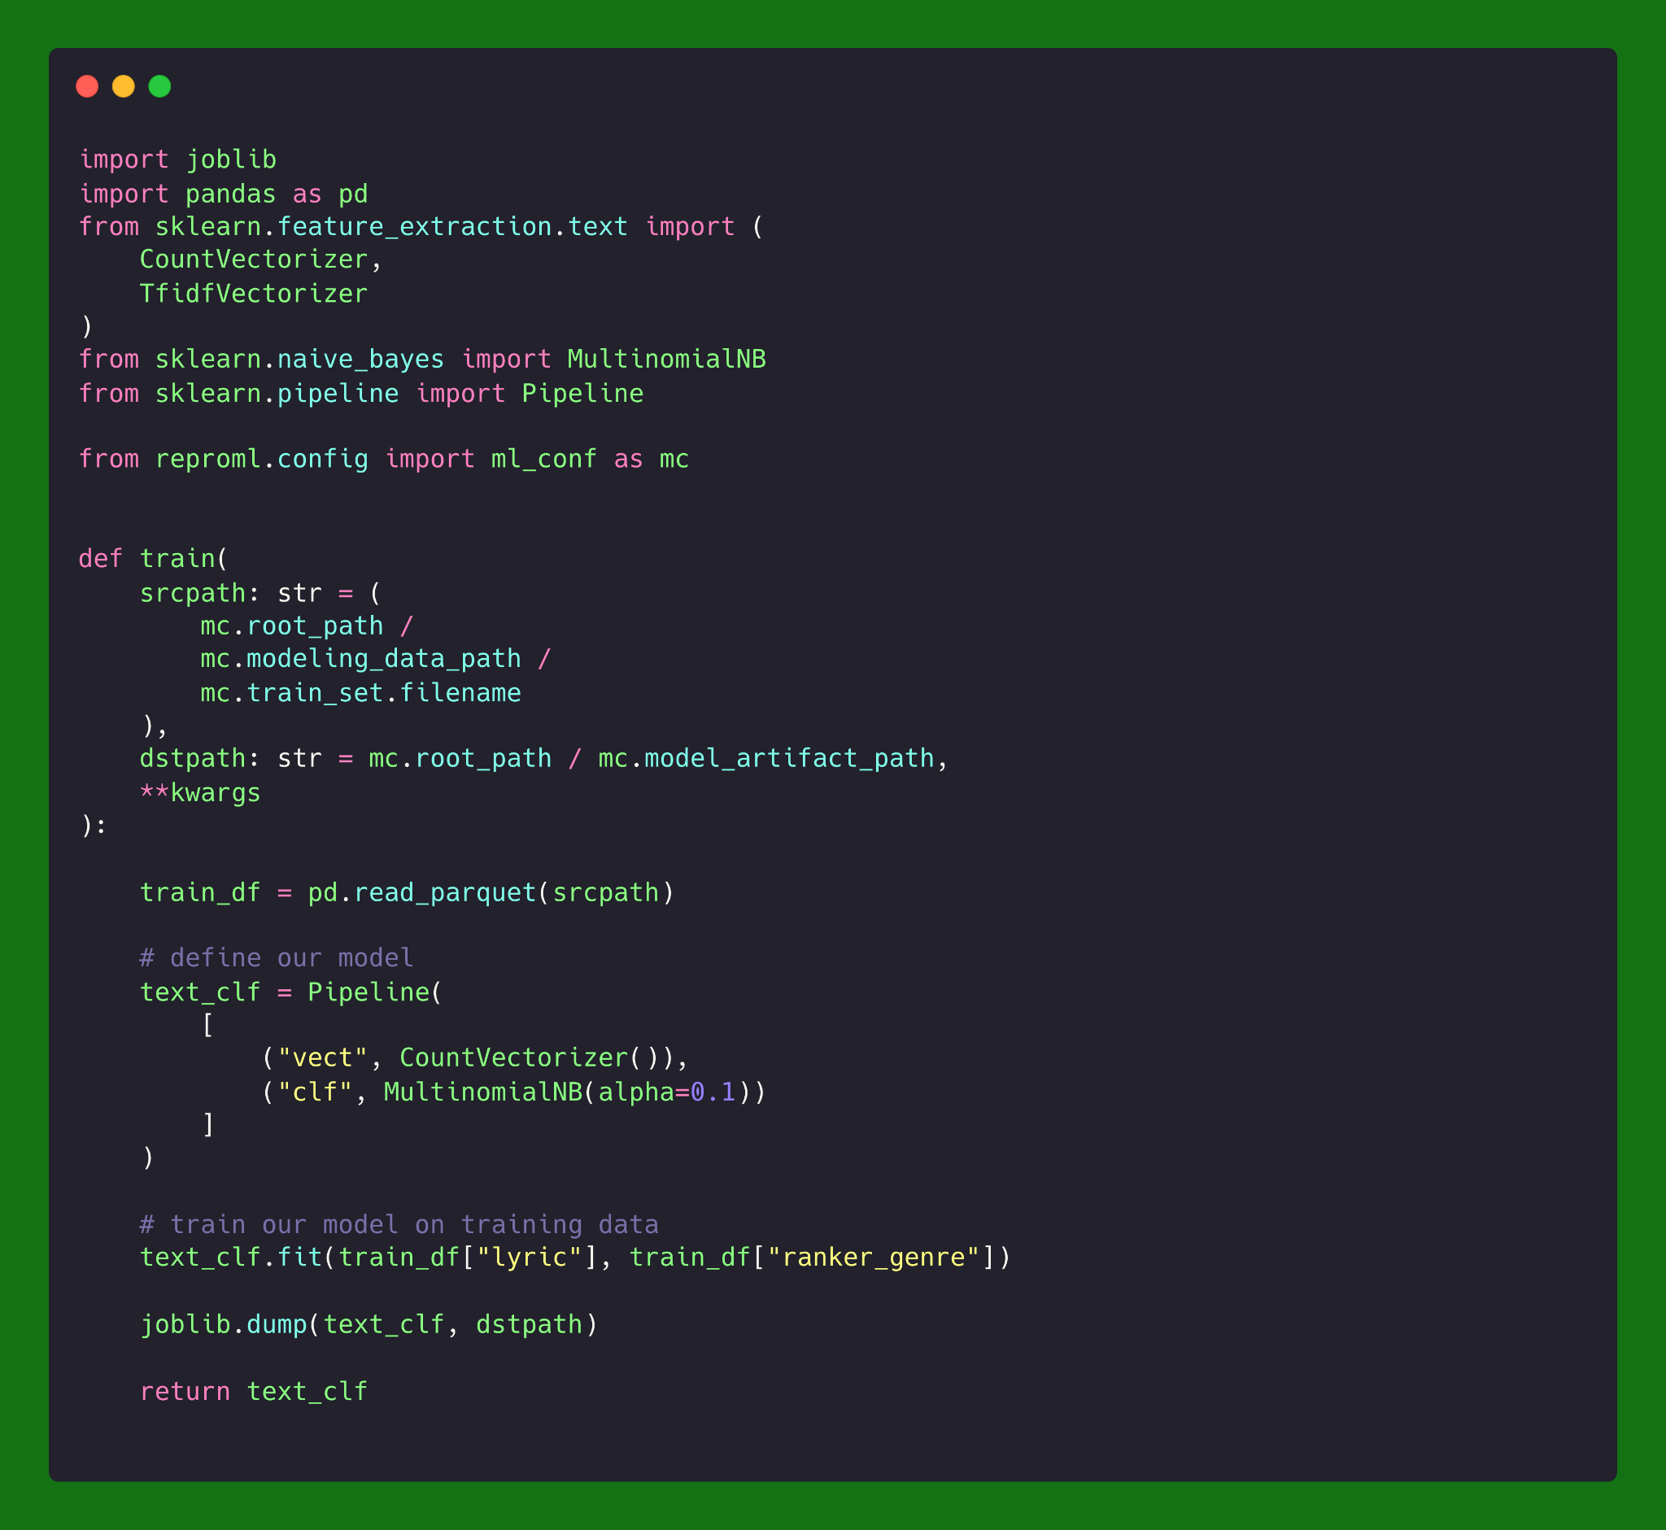
Here’s our model training code

Slide 27
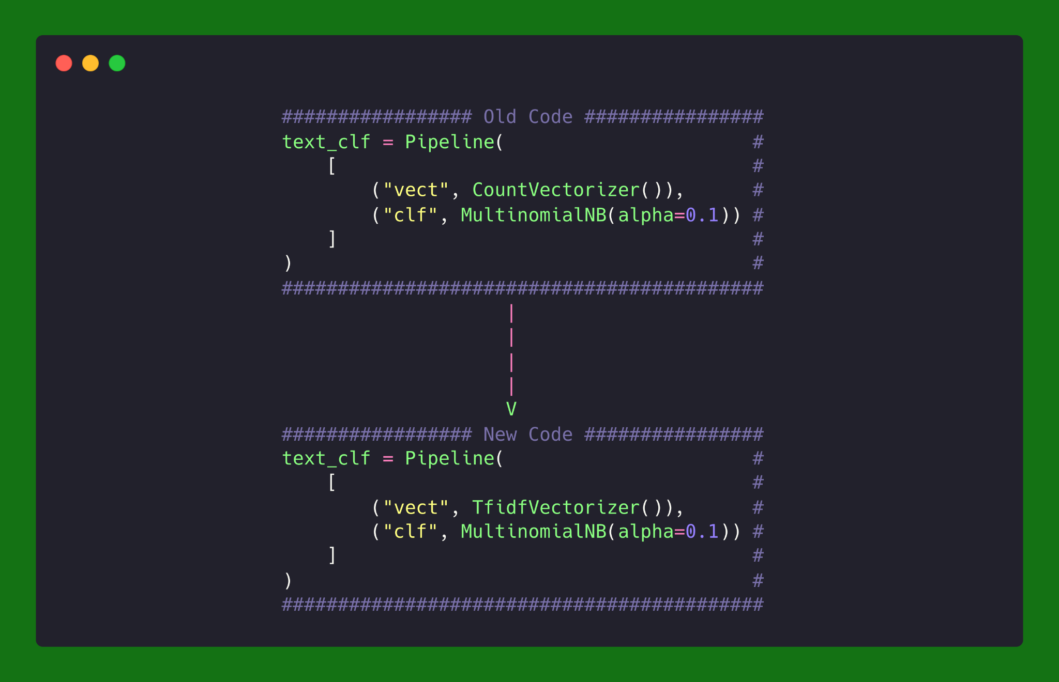
We’re going to change our training code

Slide 28
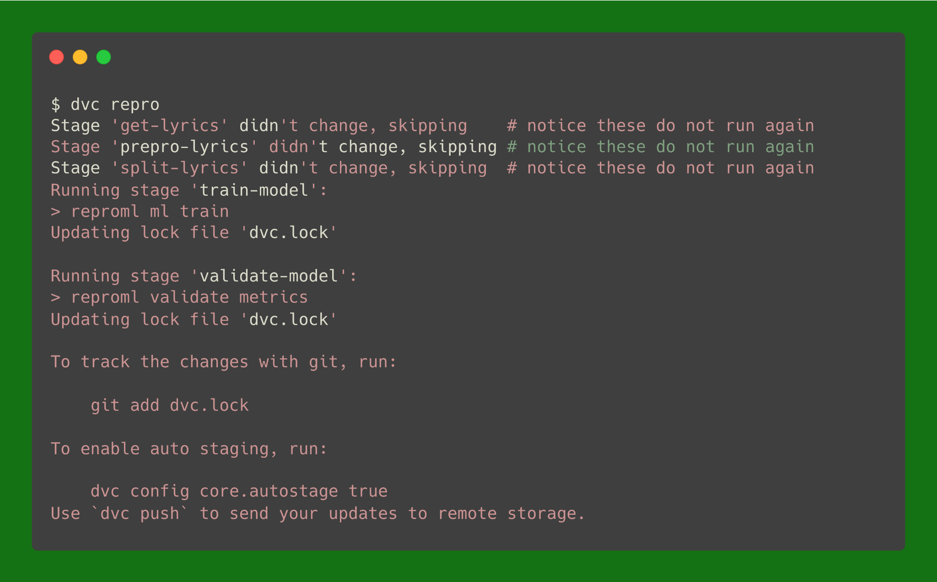
And rerun dvc repro

Slide 29
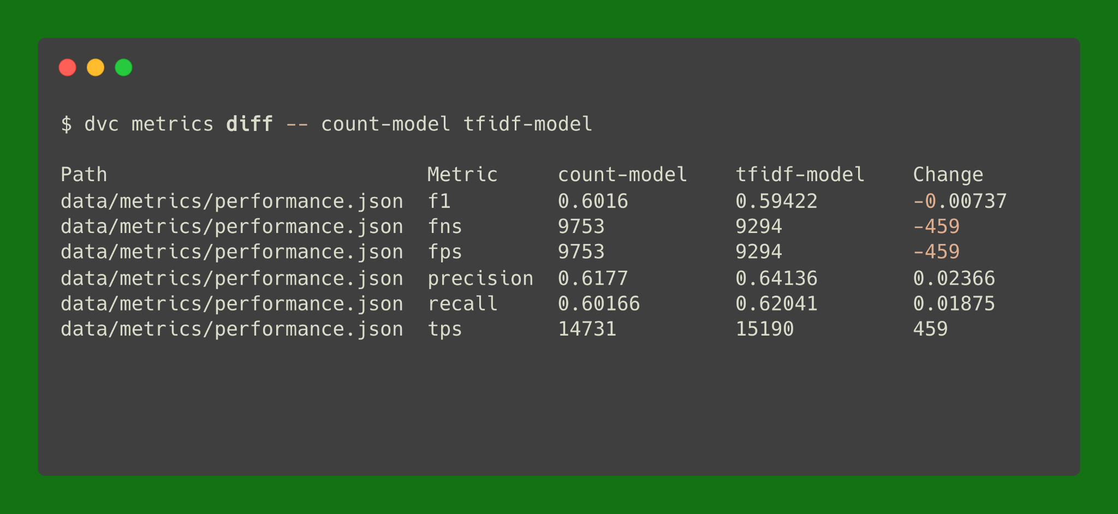
Now let’s compare metrics

Slide 30


